Slide 1

JET: A Platform for Trustworthy Computing
An Internet-scale identity system analogous to the Domain Name System (DNS)
Three cryptographic protocols:
Authorization, proof of authorization to conduct a transaction
Record Linking, proof that anonymous data relates to the same entity
Sybil Authentication, proof that accounts are held by the same (or different) person(s)

Slide 2
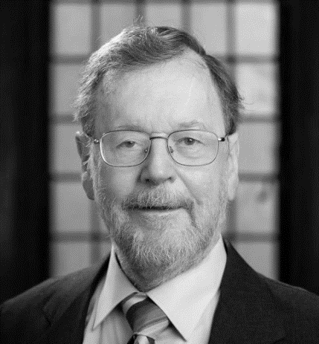



Principal Researchers
Michael Fischer, Professor of Computer Science
Daniel Boffa, Professor of Surgery (Thoracic), School of Medicine
Jonathan Hochman, Graduate Student in Computer Science
Sophia Paleologou, Yale Computer Science Ph.D. (1995); CTO of UNS Inc.

Slide 3
Just Enough Trust
A scalable decentralized identity system for privacy-preserving sharing of data
Security is based on trust agents who act on behalf of their clients
Trust agents are chosen by their users (just as people choose their bank)
Trust agents obtain services by interacting with servers’ trust agents
System isolates sensitive data (such as PII) from other content

Slide 4

JET and Blockchain
Unlike other blockchain projects:
UNS requires permission to participate. Trust node operators sign a contract and provide a financial guarantee.
JET provides proofs designed to be admissible in court.
Trust agents act as data fiduciaries for their users
However, Trust Nodes provide Lawful Access to data when there is a valid court order.
→ When you die, your heirs get your digital assets → If somebody steals your apes, you have recourse
→ If you lose your keys, your trust agent can restore access

Slide 5
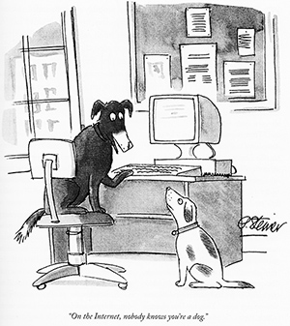
On the Internet, nobody knows you're a dog Peter Steiner
The New Yorker, July 5, 1993.
Source: Wikipedia

Slide 6
Attribution is the Root of Many Problems
Bots and troll armies to spread disinformation
Fake reviews influence $152 billion in ecommerce
Invalid traffic cost advertisers $35 billion in 2020
Users banned by platforms return with new identities
Online tracking violates privacy, leading to fines and lawsuits
De-identified medical data is difficult to link, impairing research
JET uses cryptography to link anonymized data while preserving privacy

Slide 7






Record Linking
Linked ID protects user privacy, and allows the service to link user data
Name || DOB
Trust Node
(User’s Choice)
Trust Node (Service’s Choice)
Linked ID
Two phases of encryption protect the Name || DOB.
Each participant is free to choose a Trust Node they like in a jurisdiction they like. Trust nodes are independently operated.
Service

Slide 8
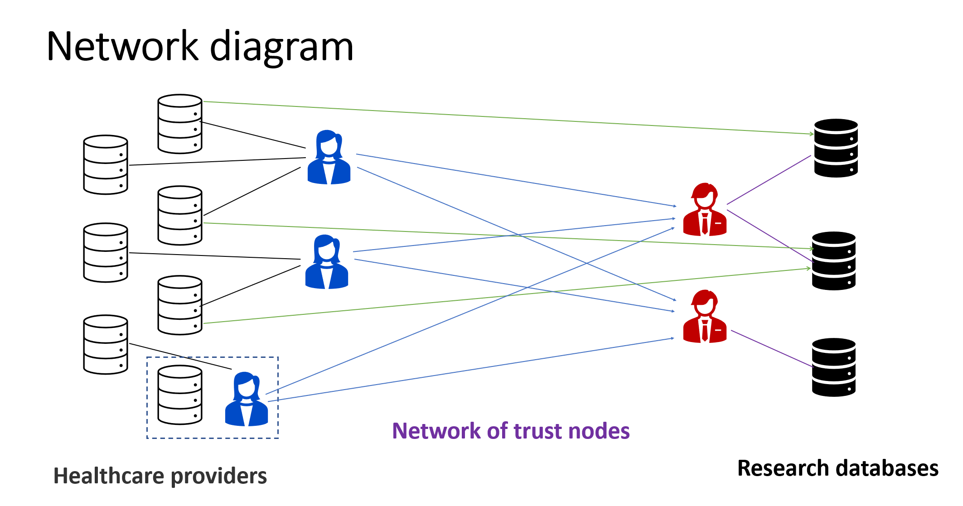

Slide 9
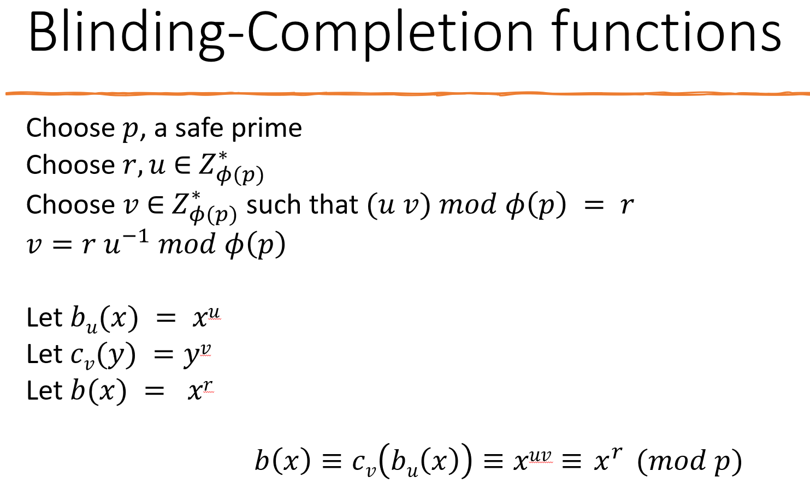

Slide 10





Dealer generates a key R_{s} for each service and “breaks” R_{s} into two shares, U_{si} and V_{si}
U_{si} goes to the trust node of the user
V_{si} goes to the trust node of the service
There are many (U_{si}, V_{si}) pairs for each R_{s}
U₀₁
Trust Node
(User’s Choice)
R₀
V₀₁
Dealer
Trust Node (Service’s Choice)
The idea of a dealer was suggested by Prof. Ben Fisch

Slide 11
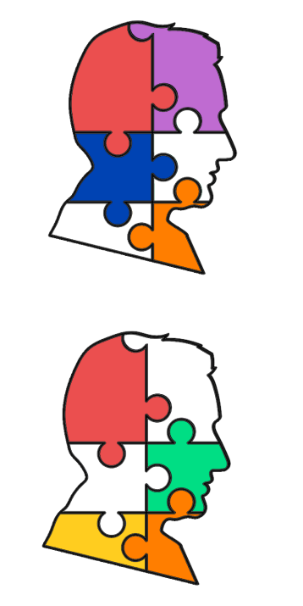
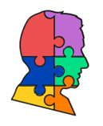
First Use: Medical Research Data
Why? High impact, easily accessible, unserved market.
De-identified data sent to Medical Research Databases
De-identified data is hard to link
Unlinked data is incomplete, duplicated, or inconsistent, which obscures medically relevant correlations
Solution: Use Linked IDs

Slide 12
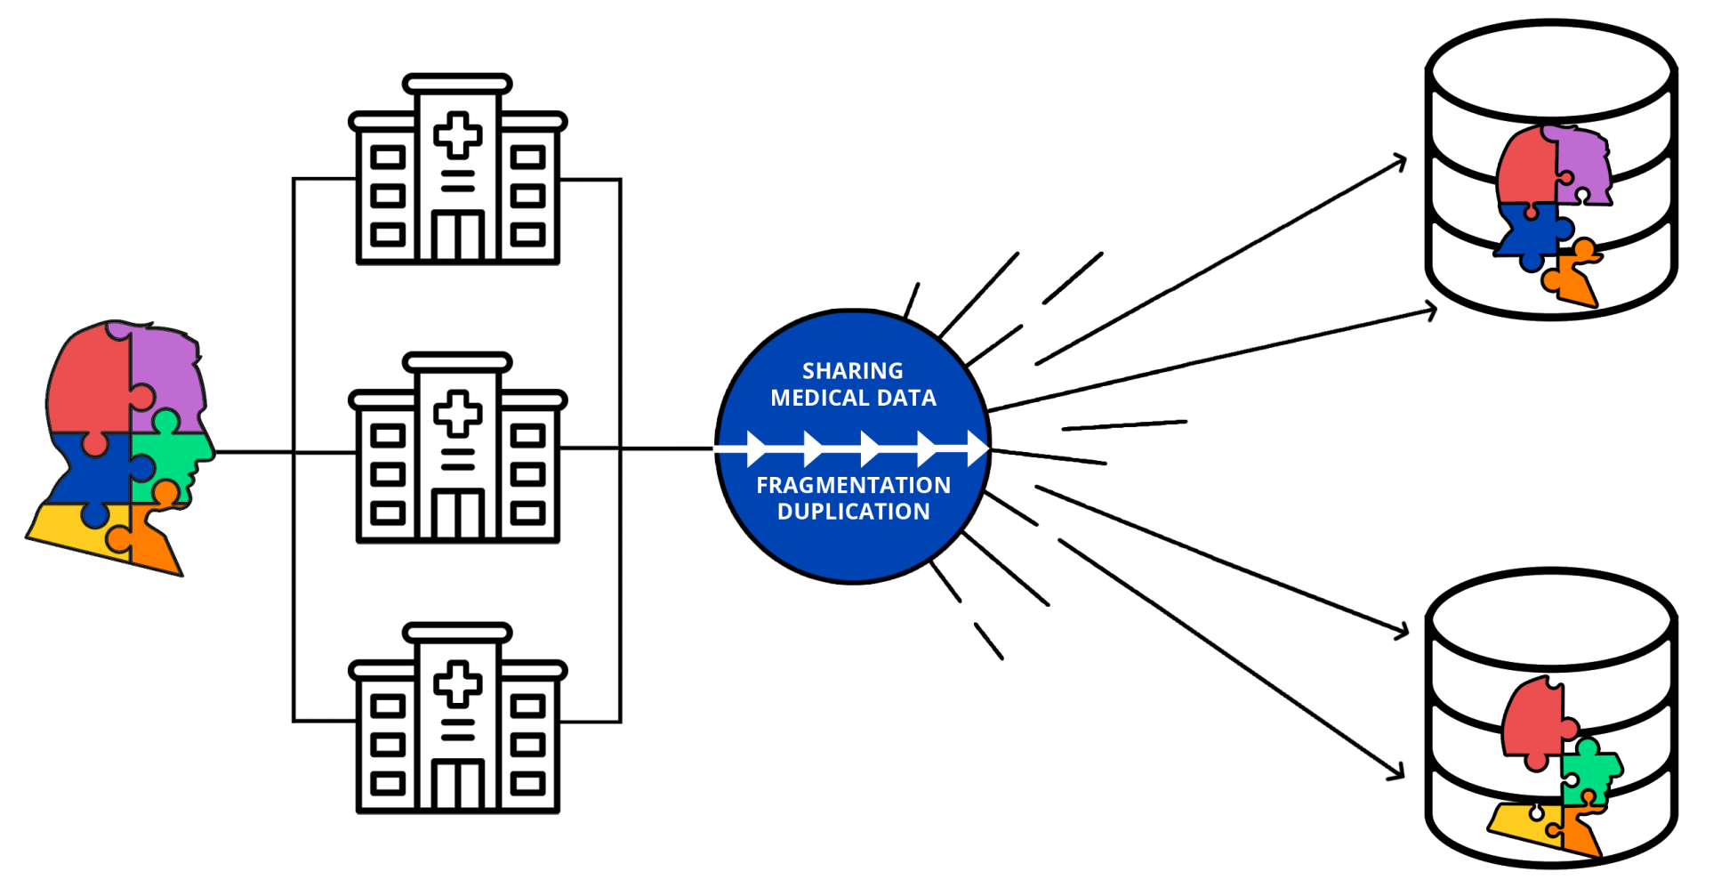
State of the Art
Research Databases are left with Incomplete, Fragmented and Duplicated Data

Slide 13
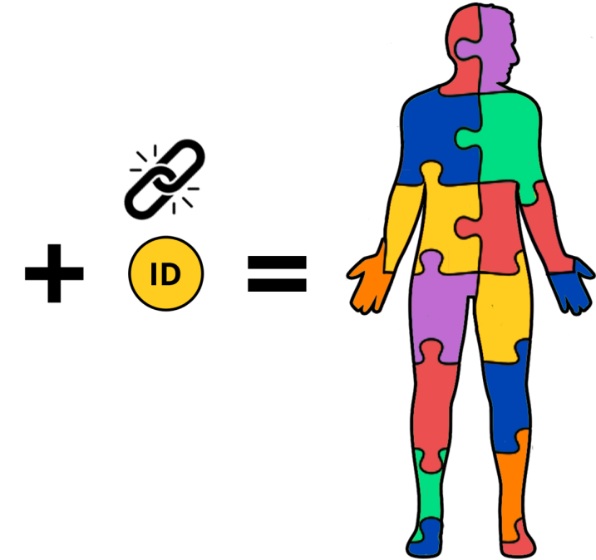

Privacy Preserving Record Linking
Medical Data → AI → Personalized Medicine
Complete Data → Better Outcomes
Yale Applied Cryptography Laboratory
Yale School of Medicine
Yale Ventures
UNS, Inc.

Slide 14
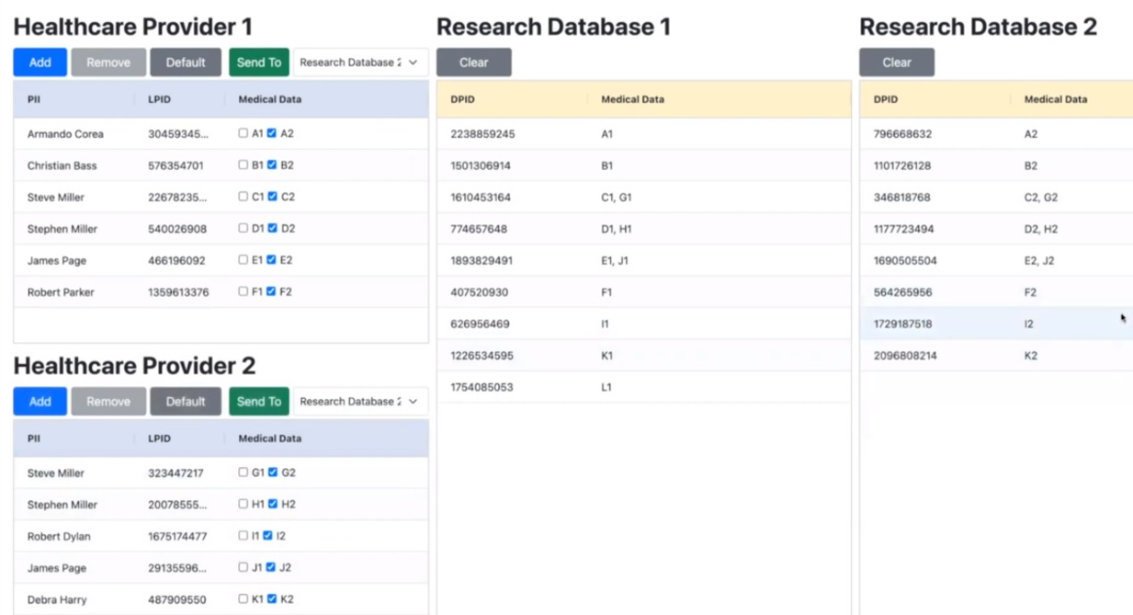

Slide 15
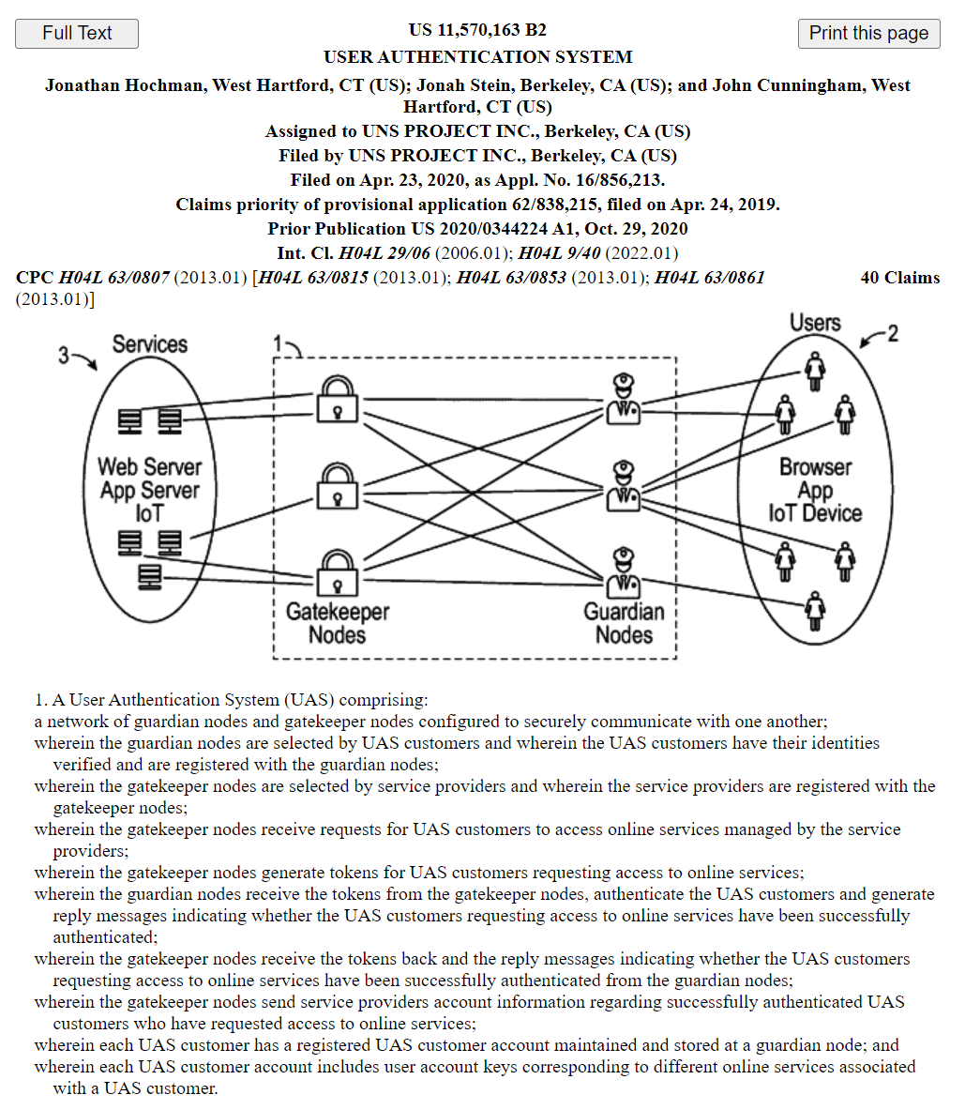
Progress to Date
Cryptographic protocol invented at Yale
One patent issued US11570163, second patent pending Application No. 63280955
Commercial partners (UNS, DATA2)
Successful pilots with synthetic data: - Yale New Haven Hospital, - St. Mary’s Hospital, Waterbury - Connecticut Tumor Registry
Received IRB approval to process real patient data
Collaboration with American College of Surgeons, National Cancer Database (70% of US hospitals)

Slide 16
What’s Next: A Platform for Trustworthy Computing
An Internet-scale identity system analogous to the Domain Name System (DNS)
Three cryptographic protocols:
Authorization, proof of authorization to conduct a transaction
Record Linking, proof that anonymous data relates to the same entity
Sybil Authentication, proof that accounts are held by the same (or different) person(s)
We are working to adapt our Record Linking solution to perform Sybil Authentication, and improve its scalability, stability, and security.

Slide 17
Record Linking ≈ Sybil Authentication
Linked ID protects user privacy, and allows the service to link user data
Real ID: Passport # Driver’s Lic.
Trust Node
(User’s Choice)
Trust Node (Service’s Choice)
Linked ID
Two phases of encryption protect the Real ID.
Each participant is free to choose a Trust Node they like in a jurisdiction they like. Trust nodes are independently operated.
Service

Slide 18

Just Enough Trust
An Internet-scale identity system that already exists as a prototype
Includes three cryptographic protocols:
Authorization, proof of authorization to conduct a transaction, such as “login”
Record Linking, proof that anonymous data relates to the same entity
Sybil Authentication, proof of unique personhood
These features are implemented via a distributed system of Trust Nodes. Importantly, each participant is free to choose a trust node they like, in a jurisdiction they like.

Slide 19


Sybil Authentication
Proof of unique personhood.
If a user has multiple accounts on a system, Sybil Authentication will reveal which accounts are connected without identifying the user.
Existing methods are:
Non-standard: they lack a standard of proof
Ad hoc: they compare IP addresses, network telemetry, behaviors
Probabilistic: partial success, may fail against sophisticated attacks
The proposed method is standard, repeatable, and reliable.

Slide 20

Etymology of “Sybil”
“Sybil is a 1976 two-part, American television film starring Sally Field and Joanne Woodward. It is based on the book of the same name[.]”
“With the help of her psychiatrist, Sybil gradually recalls the severe child abuse that led to the development of 16 different personalities. Field's portrayal of Sybil won much critical acclaim, as well as an Emmy Award.” (https://en.wikipedia.org/wiki/Sybil_(1976_film))
I wish there were a better name for what is commonly called Sybil Authentication.

Slide 21
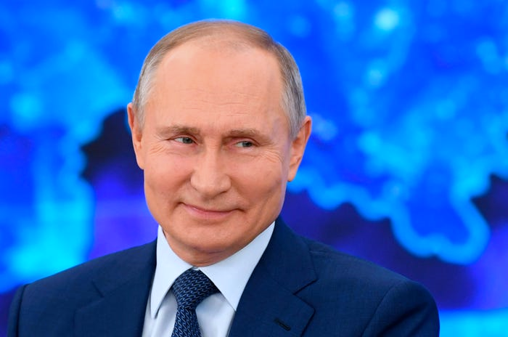
The Root of Many Problems
Bots, fake accounts, troll army are active in malicious influence campaigns. Example: Russia’s ongoing efforts to sow discord online (https://intelligence.house.gov/social-media-content/)
Fake review “farms” influence $152 billion in global spending (https://time.com/6192933/fake-reviews-regulation/). In my experience they locate in countries with vulnerable populations desperate for work
Click bots and fake traffic cost advertisers $35 billions in 2020 (https://www.searchenginejournal.com/click-bots-and-fake-traffic-cost-online-advertisers-35-billion/466804/)
When a malicious user or advertiser is banned from a platform, they may return via a new account to resume toxic behavior, leading to a game of whack-a-mole (see for example, https://en.wikipedia.org/wiki/Wikipedia:Sockpuppetry)

Slide 22

International Aspects
The Internet has few borders (with China an exception). Criminals, scams or malicious actors in one country can easily target victims in another. My experience shows a high proportion of Sybil attacks occur across borders.
Legal remedies are difficult because:
The origin country of malicious activity may have a weak legal system
Russia¹, among others, knowingly hosts organized groups that attack foreign interests.
International legal action can be prohibitively expensive.
Perpetrators often have no recoverable assets or cannot be identified.
Therefore, we need better technical defenses.
¹ See UNITED STATES OF AMERICA v. INTERNET RESEARCH AGENCY LLC (18 U.S.C. §§ 2, 371, 1349, 1028A)

Slide 23
Trust Nodes
Trusted agencies, such as banks, insurance companies, NGOs, or governments may operate Trust Nodes. Many users will already have a trusted relationship with this type of entity.
Trust Nodes operate under binding rules:
Enforceable contract, terms of service, and financial guarantee between trust nodes
Enforceable contract, terms of service, and financial guarantee to users and services
Agreement to settle disputes through a defined mechanism
It’s a permissioned blockchain.
Trust Nodes will operate in different countries. My experience is that arbitration in Switzerland under the ICC works well (see https://iccwbo.org/dispute-resolution-services/arbitration/)

Slide 24
Internet Services
An Internet service is any network connected physical or logical device or data service that allows remote connections. Examples:
Yale.edu
Amazon, Netflix, Yelp
AWS, Firebase, Cloudflare
Tesla car
Ring doorbell
You may need an account to connect. You probably agree to terms of service by connecting.

Slide 25
Technical Implementation
The proposed implementation is deterministic
It is secure to the level of established real-world processes, such as banking in person or applying for a passport
Each user chooses a trust node
Each Internet service chooses a trust node
A third trust node is chosen to acts as “dealer”

Slide 26

User Proves Identity
The user selects a Trust Agent, such as their favorite Bank, Insurance Company, NGO, or Government Office in a jurisdiction where they trust the Rule of Law. Dissidents might need to travel or find a helpful agency.
User shows their Trust Agent a real-world identity document, such as a passport, driver’s license, or other unique credential that may be available from trustworthy agencies.
The Trust Agent operates a Trust Node. The Trust Node escrows the real-world credential information and keeps it confidential.

Slide 27




Sybil Authentication / Record Linking
The Linked ID does not identify the user, but is always the same
regardless of which Trust Node a user chooses
User’s Real ID
Trust Node
(User’s Choice)
Trust Node (Service’s Choice)
Linked ID
Service
The blue key encrypts the identifier. The red key encrypts it some more.
Nobody can reverse the encryption without help from the trust nodes.

Slide 28

Lawful Access
If a user is under investigation or involved in a lawsuit, a court with proper jurisdiction can order the user’s trust node to provide information that connects a Linked ID to a Real ID.
This process creates accountability for online activities, while allowing legitimate pseudonymous activity to proceed.
Online platforms benefit from Section 230 immunity. Actions by users are the users’ responsibility, not the platforms’ (except for CSAM and other carve outs).
Linked IDs balance privacy and accountability and allow platforms to cooperate with law enforcement. This might prevent further erosion of Section 230.

Slide 29
For Discussion
Does this system worsen or improve online privacy?
Will this reduce the risk of harassment, crime, and malicious activity?
How can law incentivize platforms to root out covert influence campaigns, review manipulation, and advertising fraud?
What if government pressures a trust node to break its agreements?
Should this system support lawful access?

